Slide 1

Real time streaming
The problem revolves around creating an efficient patient monitoring and alerting system in healthcare.
This system must monitor patients' vital signs in real-time, integrate data from various sources, and promptly alert healthcare providers to any abnormalities.

Slide 2
Use cases ( End User : Healthcare Provider)
Use Case: Monitor patient vital signs (heart rate, temperature, blood pressure) in real time.
Implementation: Stream patient data to identify and count instances where vital signs indicate a potential health concern.
Benefit: Enables healthcare providers to promptly respond to critical patient conditions and trigger alerts or interventions

Slide 3
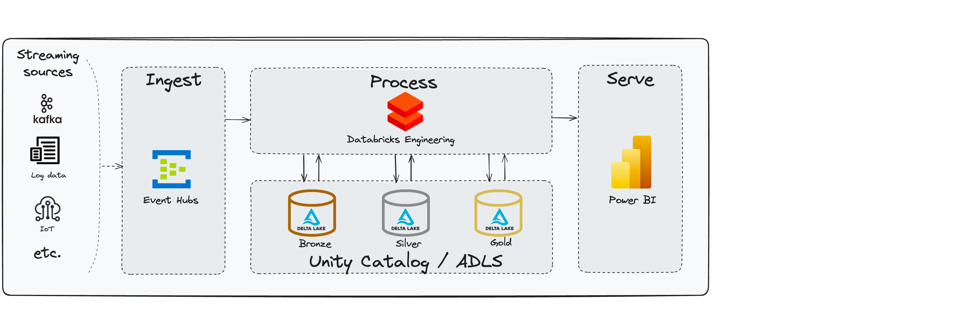
Architecture

Slide 4
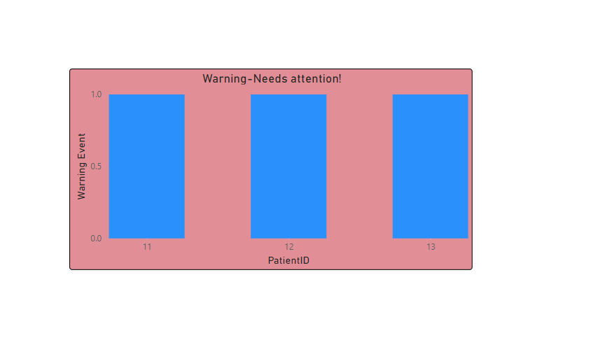
Visualization

